Slide 1

CRIME RATE ANALYSIS
A presentation by
K Ajay Kumar
A Krishna Vamshi
G Koushik

Slide 2
CONTENTS:
PROBLEM STATEMENT
INTRODUCTION
PACKAGES USED
GATHERING AND EXPLORING DATA
PREPARING THE DATA
SPLITTING THE DATA
INITIALIZING THE MODEL AND PARAMETERS
TRAINING THE MODEL
TESTING THE MODEL
EVALUATING THE MODEL

Slide 3
PROBLEM STATEMENT:
The idea behind the project is to develop a model that predicts the nature of crime that takes place for different set of attributes such as hour ,day ,district ...

Slide 4

INTRODUCTION:
Criminal activities are present in every region of the world affecting quality of life and socio-economic development
Law enforcement agencies use different patrolling strategies based on the previous data.
This analysis can be done by using
Machine learning.

Slide 5
PYTHON PACKAGES USED:
Numpy
Pandas
Sklearn-(SCIKIT LEARN)
Stats model
Seaborn
Matplotlib

Slide 6
About Packages:
NUMPY: Numpy is a library for the python programming language, adding support for large, multidimensional arrays and matrices, along with a large collection of high-level mathematical functions to operate on these arrays.
PANDAS: It is used for structured data operations, manipulations, used for demunging and preparation.
MATPLOTLIB: One of the greatest benefits of visualization is that it allows us visual access to huge amounts of data in easily digestable visuals. Matplotlib consists of several plots like line,bar,scatter,histogram etc,,..
SCIKIT LEARN :Simple and efficient tools for data mining and data analysis . Accessible to everybody, and reusable in various contexts .Built on NumPy, SciPy, and matplotlib Open source, commercially usable - BSD license
STATS MODELS: It is used to perform statistical operations on the taken models.
SEABORN : It is similar to matplotlib but adds more visualization to the graphs.

Slide 7
Types of classifiers used:
1.KNN CLASSIFIER
In pattern recognition, the k-nearest neighbors algorithm (k-NN) is a non-parametric method used for classification and regression. In both cases, the input consists of the k closest training examples in the feature space.
2. RANDOM FOREST
The Random Forest Algorithm Random Forest is a flexible, easy to use machine learning algorithm that produces, even without hyper-parameter tuning, a great result most of the time.

Slide 8
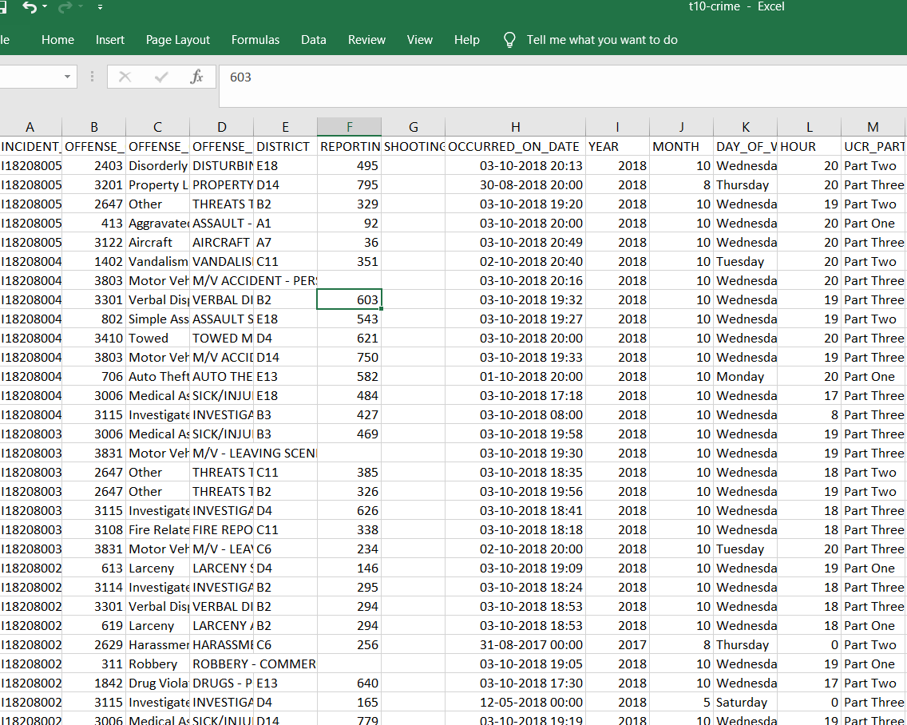
1.Gathering and Exploring Data:
Gathering the data involves bringing together all the different sets and types of data, organizing them into a table like format consisting of row and columns i.e.., in a CSV format.

Slide 9
EXPLORATORY DATA ANALYSIS
Exploring the data helps us to identify errors or spot inconsistencies which we might need to deal with early on. Furthermore, it allows us to decide the type of model or algorithm suitable for the problem at hand. let us inspect the volume and structure of the data using describe() method.
The descriptive statistics portion allows us to understand the spread of our data, by using the describe() method:

Slide 10
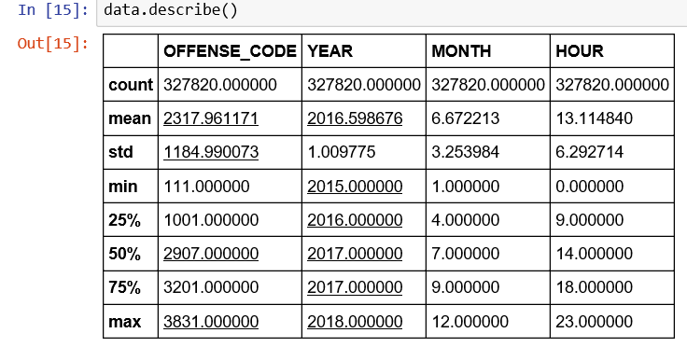
For every quartile(25%,50%,75%) the percentage has been increased for each and every feature.

Slide 11
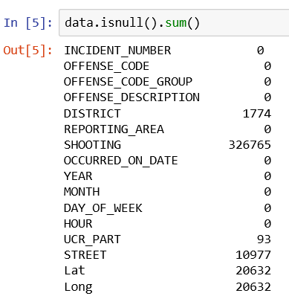
2. PREPARING THE DATA:
The second step is where we do all the data wrangling, tranformation, cleaning and fixing after exploring our dataset. Depending on the size and complication of the data this could take up considerable time and resource.
Initially make sure that your data doesn’t contains any missing values
The above contains missing values so we have to refine the data and remove null values

Slide 12
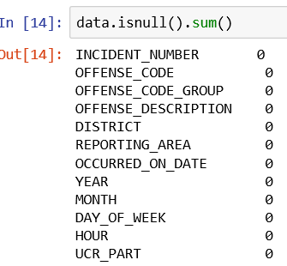
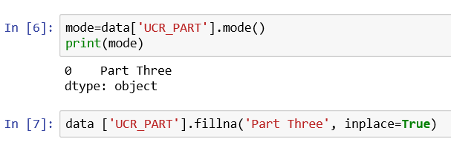
The following procedure can be followed to ensure that there are no missing values in the data set.

Slide 13
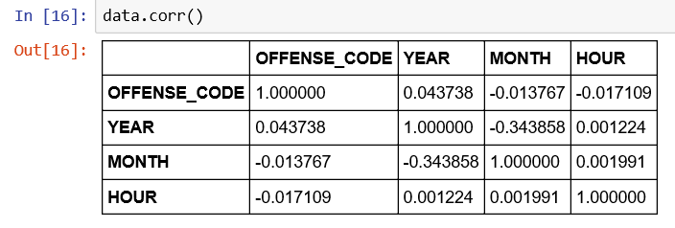
WORKING WITH DATA:
Checking for the multi co-linearity using the corr() which is a big problem in regression models. Correlation values ranges between -1 and 1.
Correlation tells both the magnitude and the direction i.e.., the strength of the relation between the pair of attributes.
when value is exactly +1 or close to it ,called strong +ve correlation
when value is exactly -1 or close to it ,called strong -ve correlation
when value is above 0.5,called weak +ve correlation
when value is below 0.5,called weak -ve correlation
when value is below 0,called no correlation

Slide 14
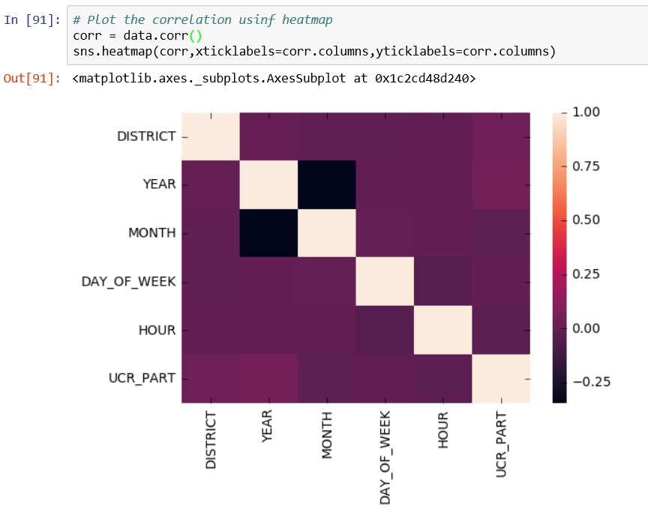
Graphical visualizing the correlation is done by the using heat map. The colors in heat map decides the relation between two variables

Slide 15
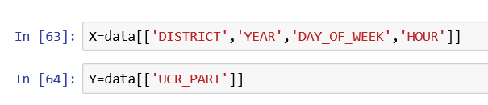
3 .Initializing the Model and Parameters :
Selecting parameters:
While selecting the parameters, the variables that depend on other variables are the target variables which depends on the independent variables called features.
All features are packed in a single parameter and target variable as another parameter
Similar model with different parameter values could result in very different out outcomes.
In our problem the parameters selected are:

Slide 16
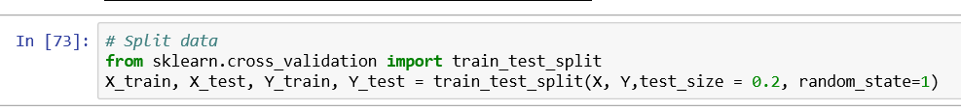
4.Splitting the Data :
we should be preparing the data for our regression model by splitting our data into two distinct sets of data —one for Training and another for Testing.
While splitting the split portion of the train data must be greater than the train data.

Slide 17
Stats model :
Generally these models are used for analysis of data through “MATHEMATICAL SCIENCES”.
Here depending on r2,adj.r2,test_significance,p are the factors to be considered to determine/predict best model.
R-squared explains the amount of variability of the models which is attributed to the independent variables. It tells us how well did our model fitted to the data. R-squared values always range between 0 and 1, generally the higher the value the better.
The adjusted R-squared is a modified version of R-squared that has been adjusted for the number of independent variables in the model.
i. If p<(reject null hypothesis)
ii. Else accept null hypothesis

Slide 18
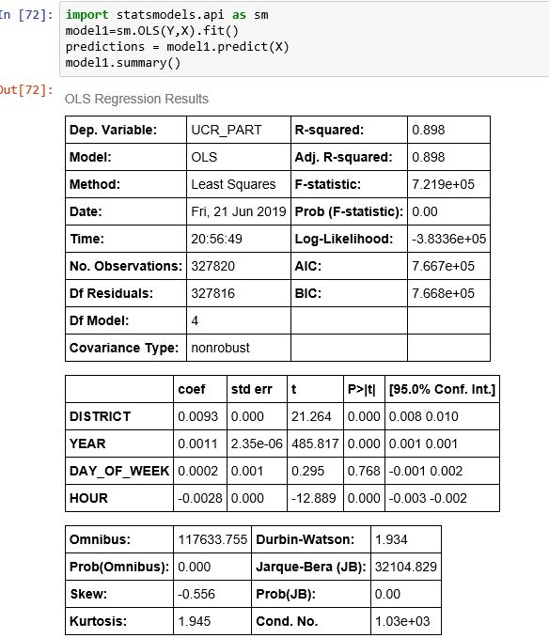
Since the p values of max of all the attributes are less than 0.5 , we reject null hypothesis which means that the feature variables have an relation with the target variable
Hence we proceed further by initializing a model from sklearn to prove the alternative hypothesis

Slide 19
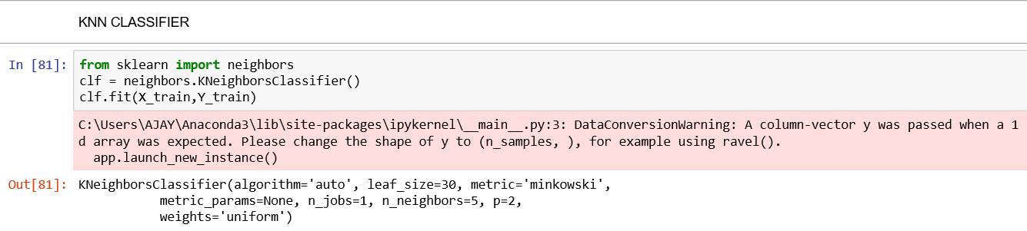
Selecting and training the model:
Selecting the model isn’t very difficult when we choose the right algorithm which suits the problem.
1.KNN classifier

Slide 20
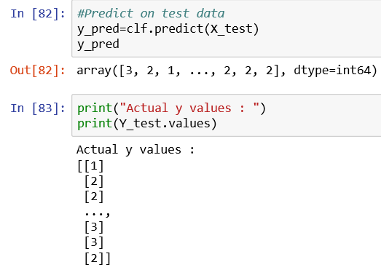
6 . Testing the model :
We can now run our test data through the trained KNN model. The output will be our model’s prediction of given values of the independent variables as follows:

Slide 21
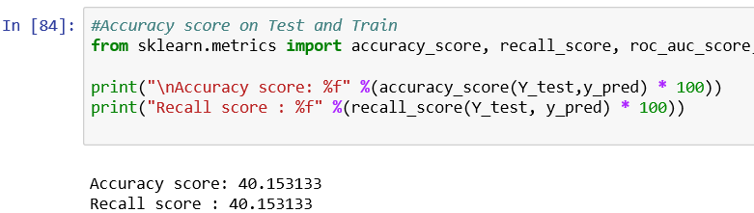
Accuracy of the model
Thus The accuracy of the model using KNN classifier is nearly 40%

Slide 22
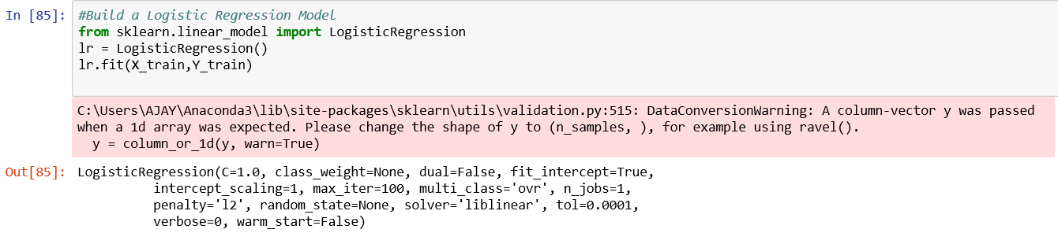
2.Logistic Regression

Slide 23
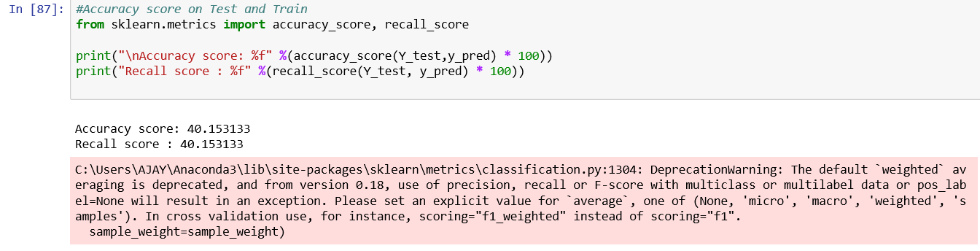
Accuracy of the model
The accuracy of the model built using Logistic regression is nearly 40%

Slide 24
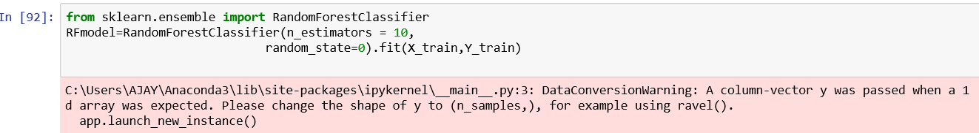
3.Random Forest Classifier

Slide 25
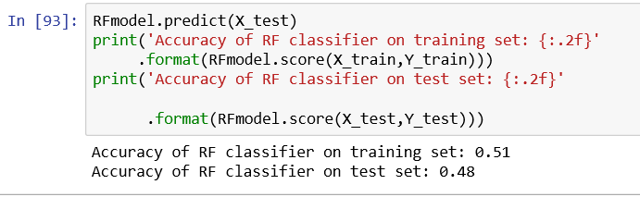
Accuracy of the model
The accuracy of the model using Random Forest classifier is nearly 51%.

Slide 26
Selection of the accurate model :
The accuracy of KNN classifier on test set is : 40%
The accuracy of Logistic regression on test set is : 40.15%
The accuracy of Random Forest classifier on test set is : 51%
So, We conclude that the accuracy among KNN , Logistic Regression , Random Forest Classifier the accuracy is greater for Random Forest with an accuracy of 51 percent.

Slide 27
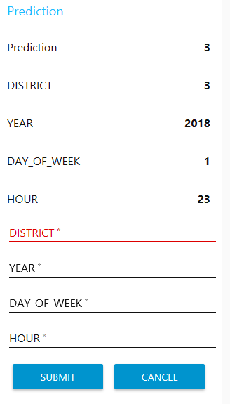
Online link generated using node-red-dashboard to access the model and make predictions.
https://crimeratenodered.eu-gb.mybluemix.net/ui/#!/0?socketid=6W6hXxoV4q0b5Ak5AAAC

Slide 28
CONCLUSION:
Throughout the research it has been evident that basic details of criminal activities in an area contains indicators that can be used by machine learning agents to classify a criminal activity .

Slide 29
THANK YOU

